Slide 1

HustleHub
DevMates:
1. Divya Prakash: prakash.di@northeastern.edu
2. Priyanka Basavaraj Bhadrappanavar: bhadrappanavar.p@northeastern.edu
3. Shivani Sugurushetty: sugurushetty.s@northeastern.edu
4. Shriya Pratapwar: pratapwar.s@northeastern.edu

Slide 2

Project Description
HustleHub application is a digital platform where clients can post their projects, detailing required skills, timelines, and budgets. Freelancers then browse these listings and communicate with client to showcase their qualifications for consideration , then freelancers are selected by clients to work on their project. Following project completion, clients will review and provide feedback to the freelancer.By offering tools for handling contracts and payments, the platform facilitates collaboration.

Slide 3


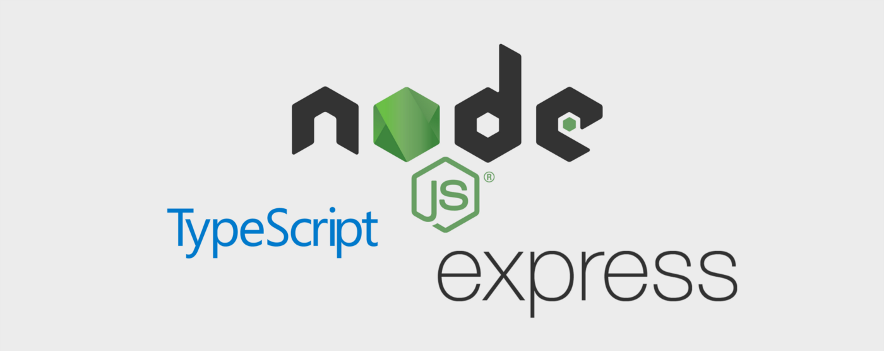



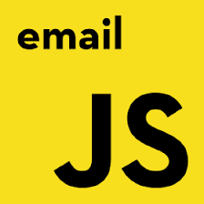
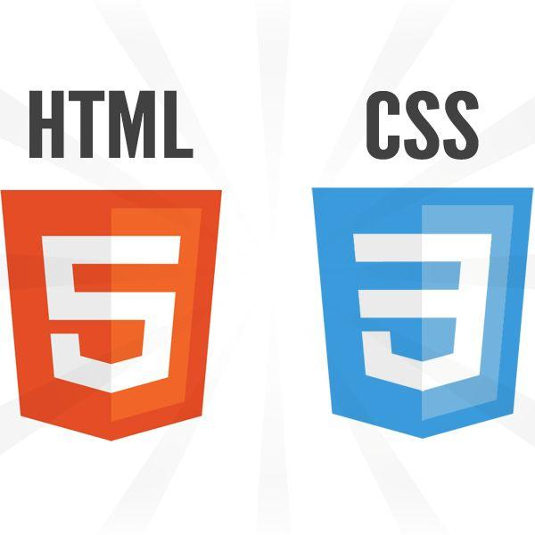

Technologies Used

Slide 4

Our Mission
At HustleHub, we aim to revolutionize the way businesses and freelancers collaborate. By offering a transparent, reliable, and efficient platform, we empower clients to find the best talent for their projects, while helping freelancers to grow and succeed in their careers.

Slide 5
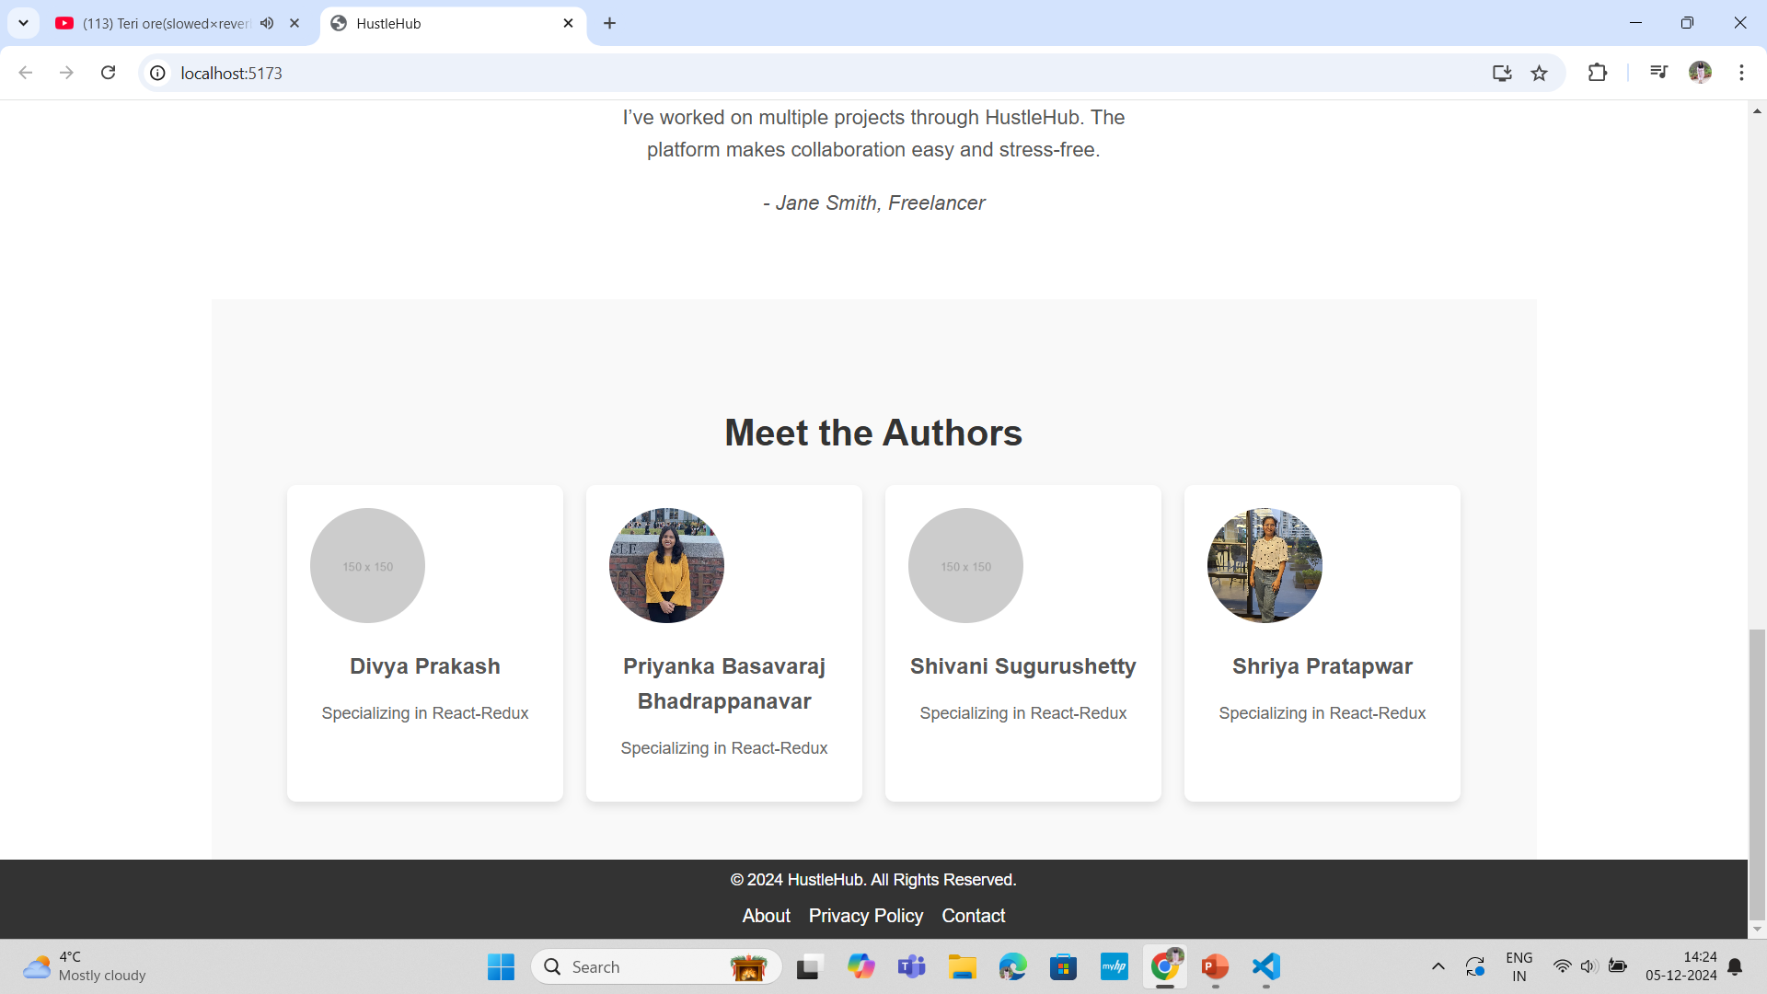
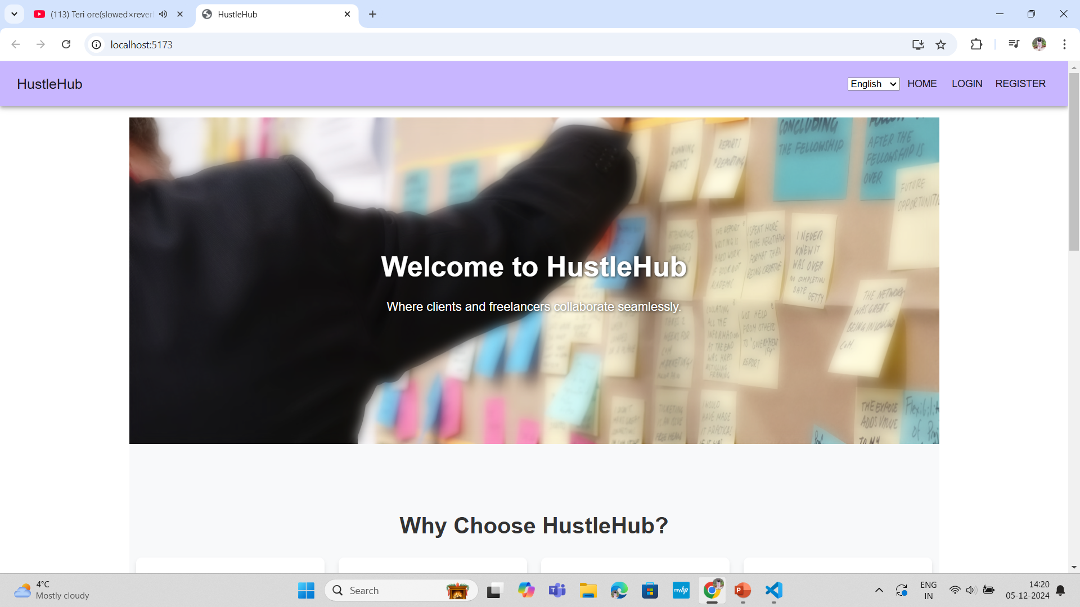
Home Page

Slide 6
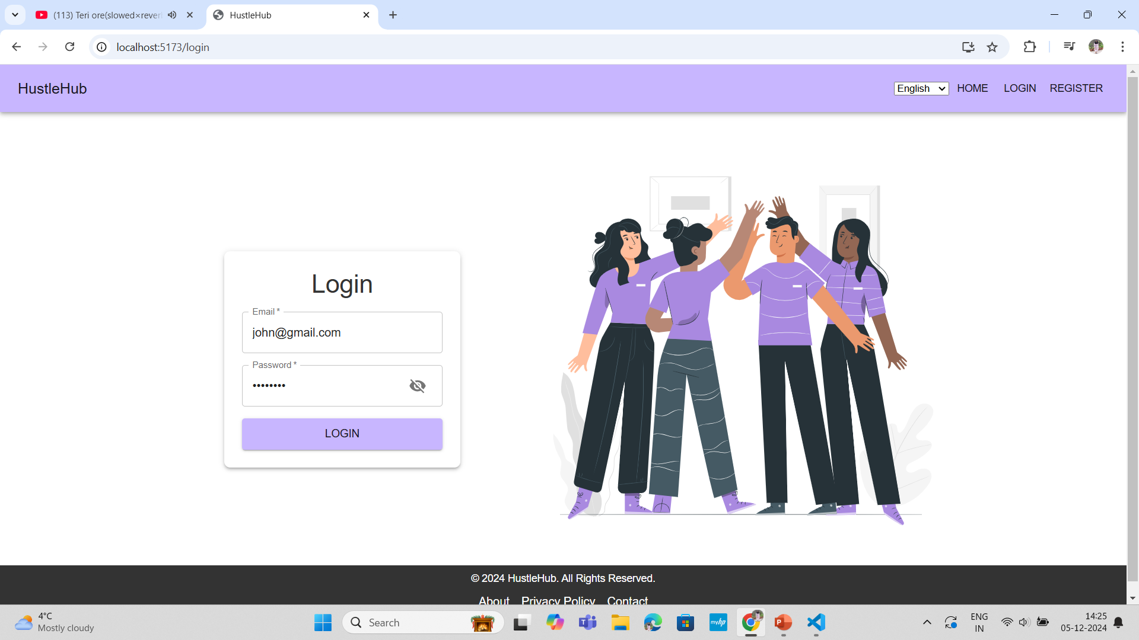
Login Page

Slide 7
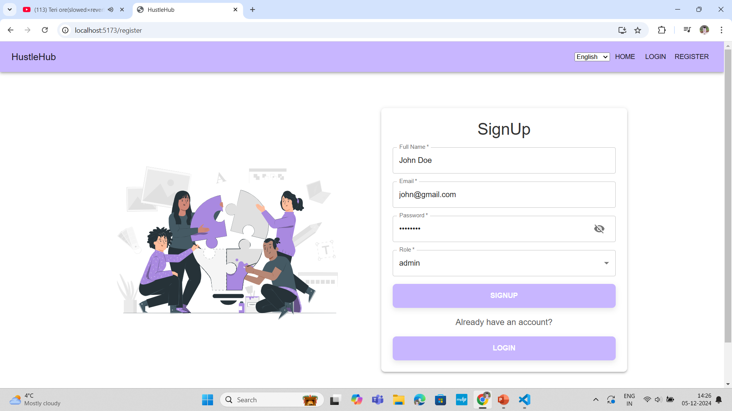
Register Page

Slide 8
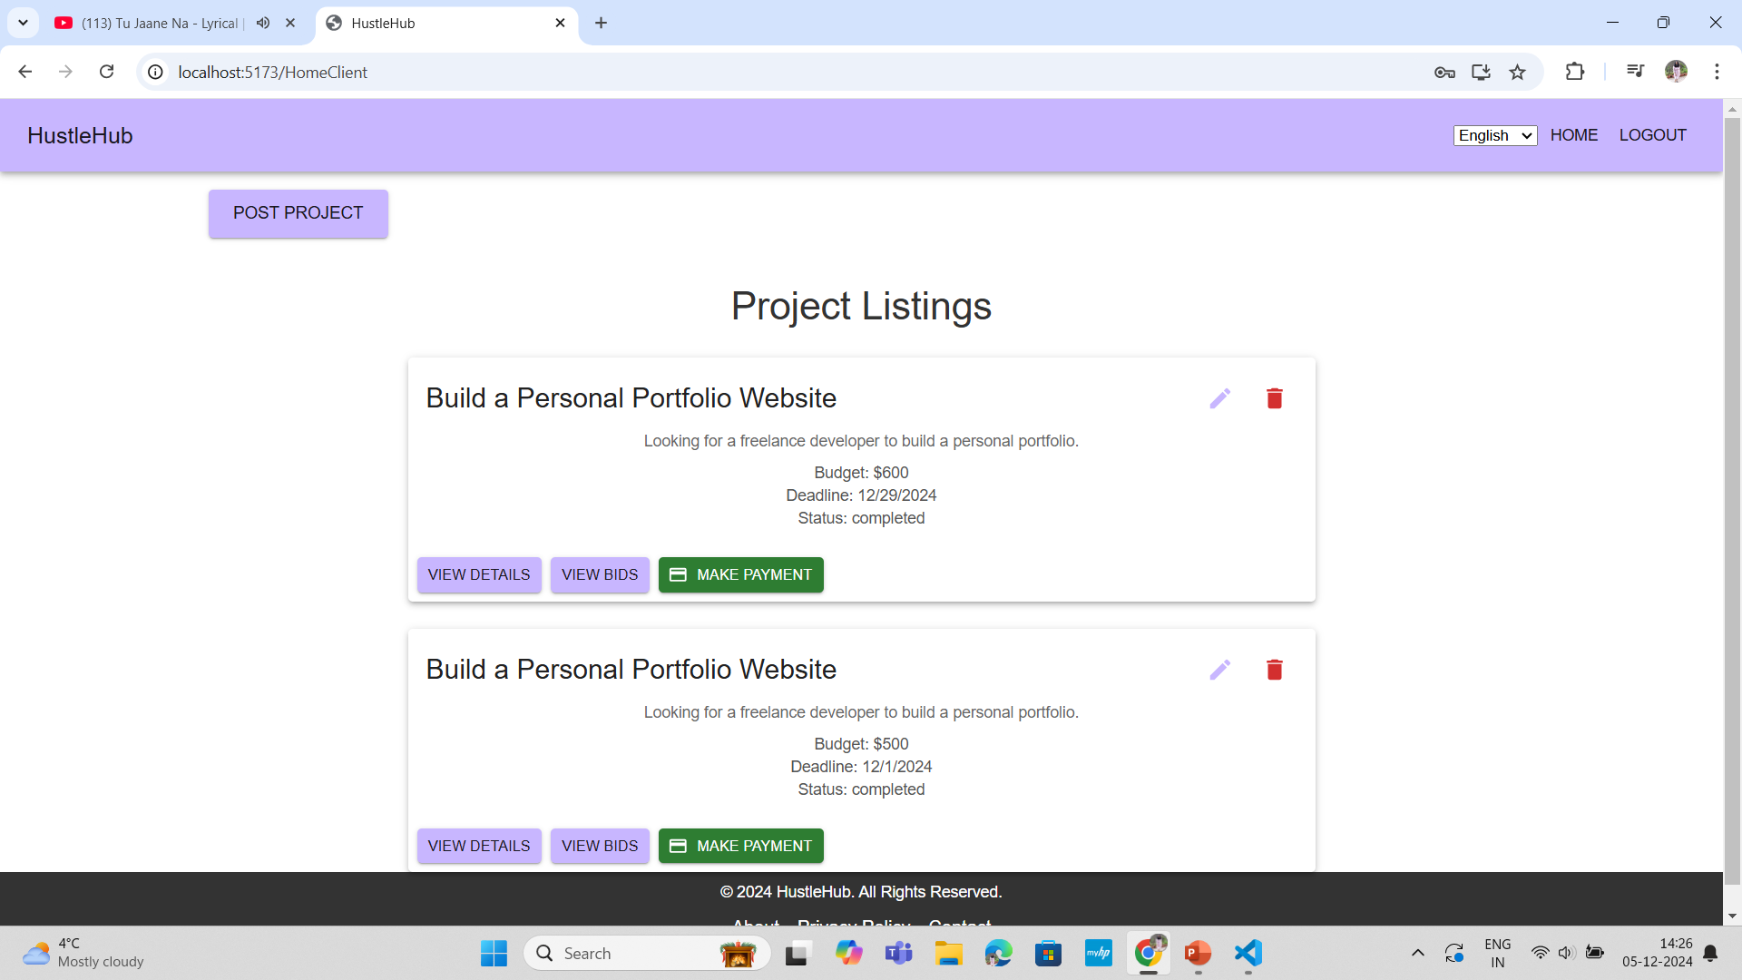
Client Dashboard

Slide 9
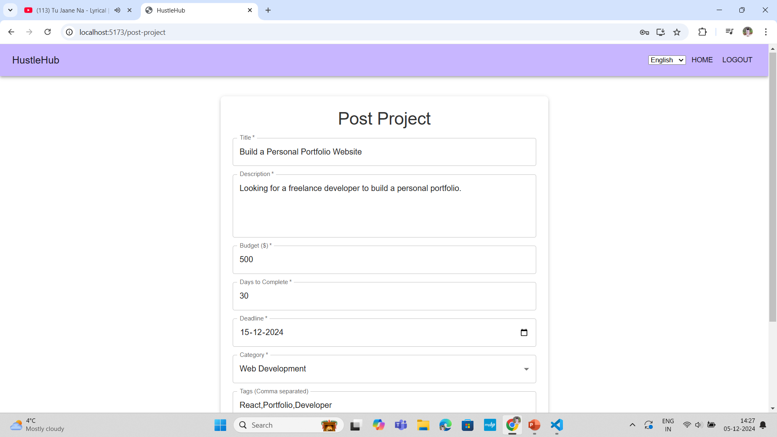
Post Project Form

Slide 10
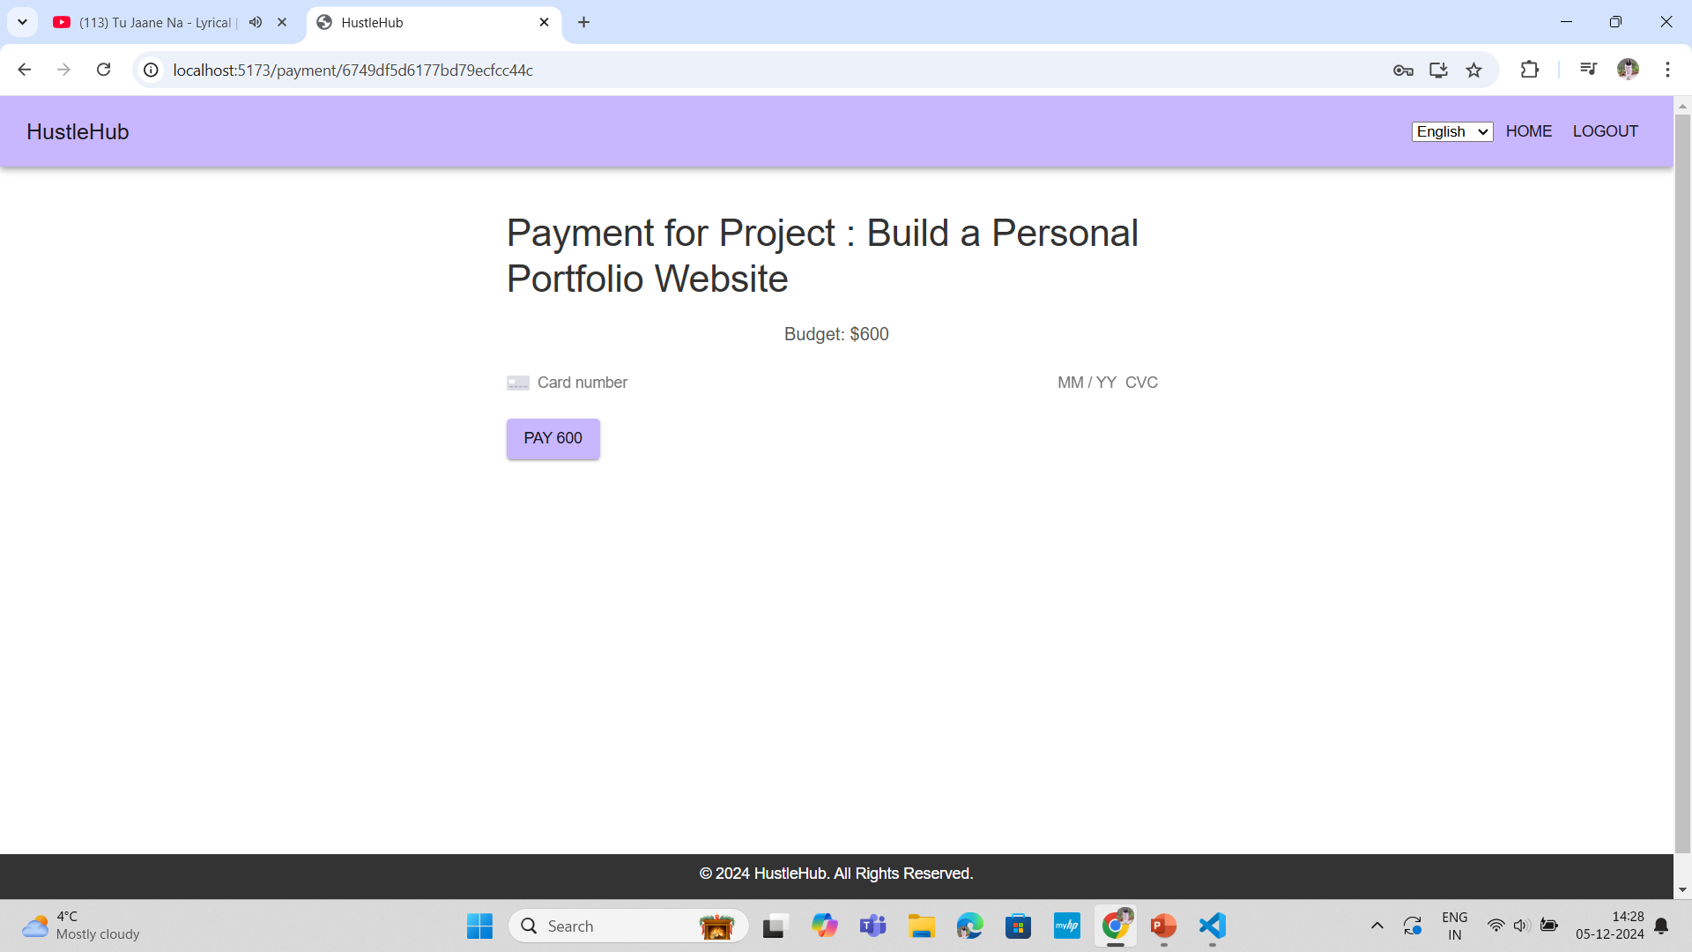
Payment Page

Slide 11
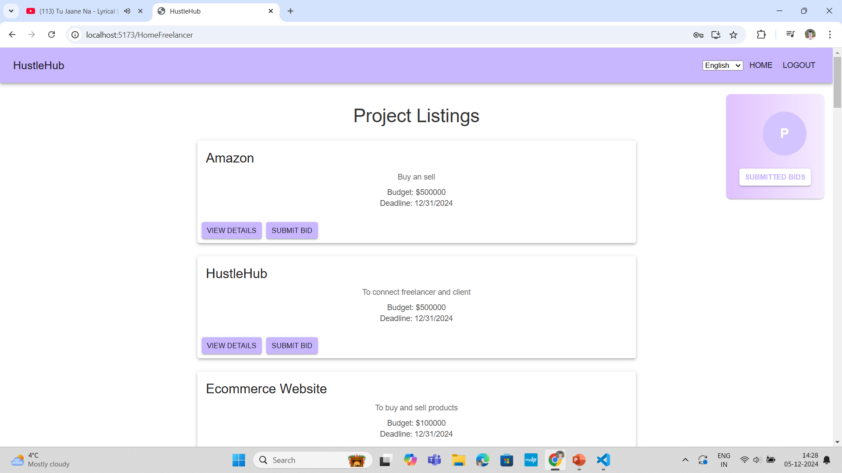
Freelancer Dashboard

Slide 12
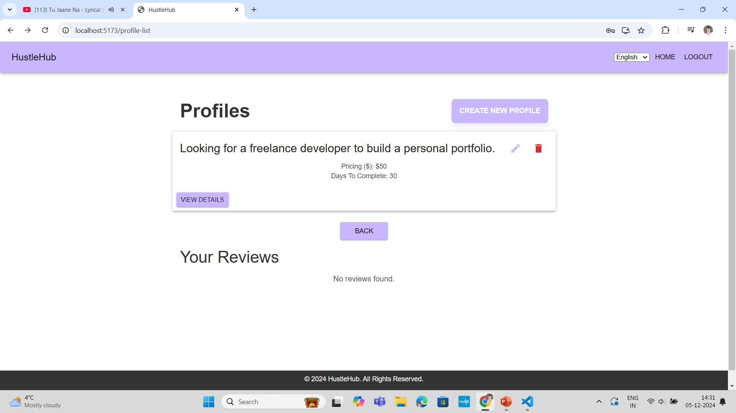
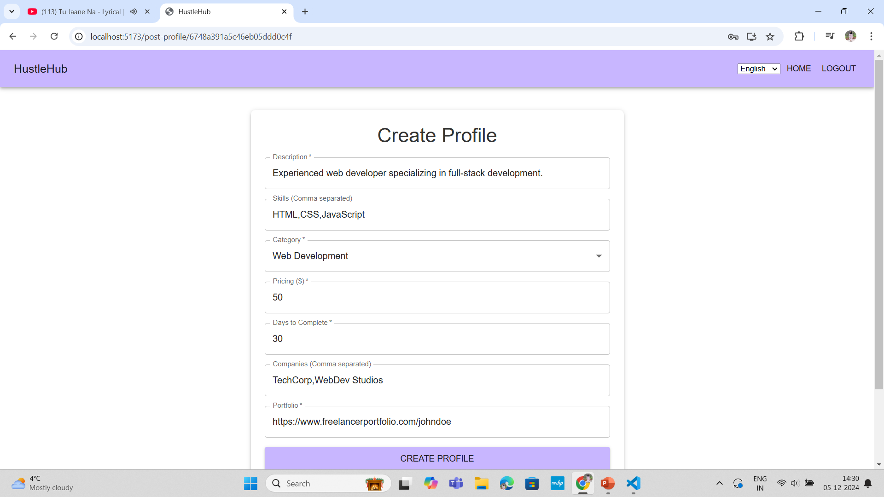
Freelancer Profile Create form and List of it

Slide 13
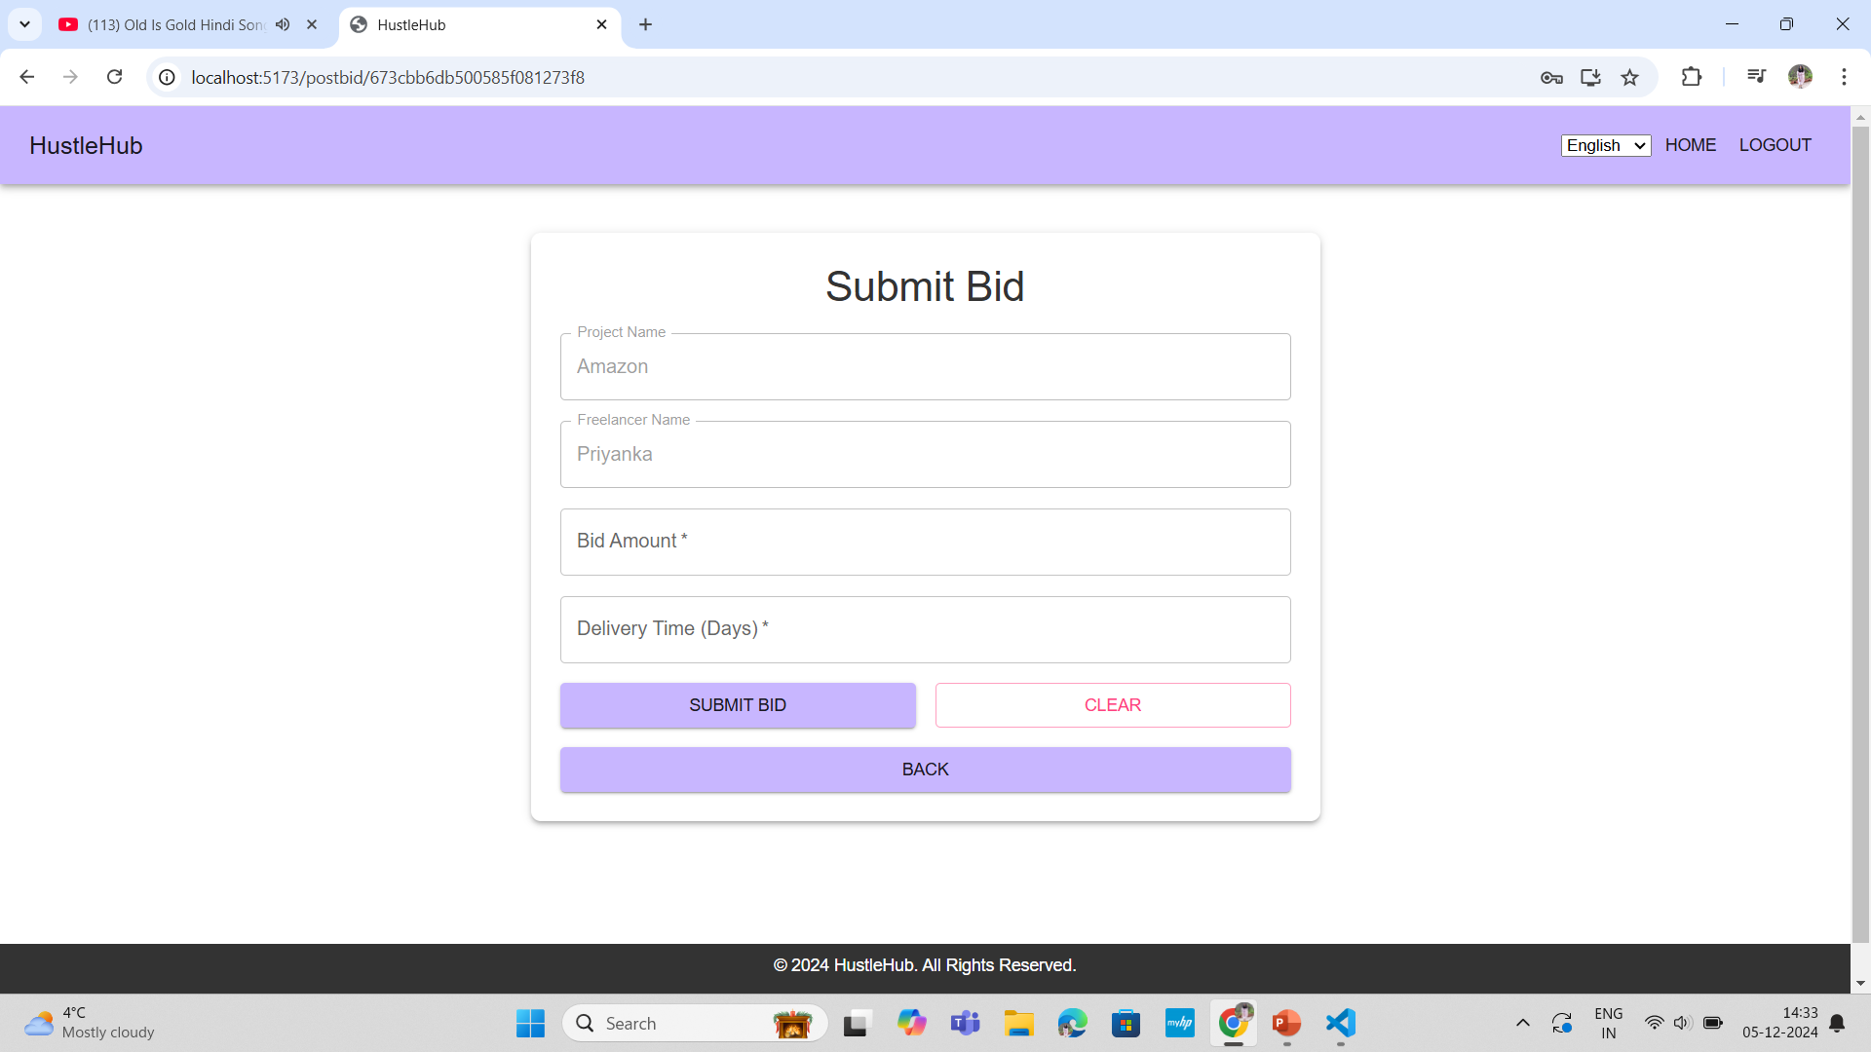
Post Bid Form

Slide 14
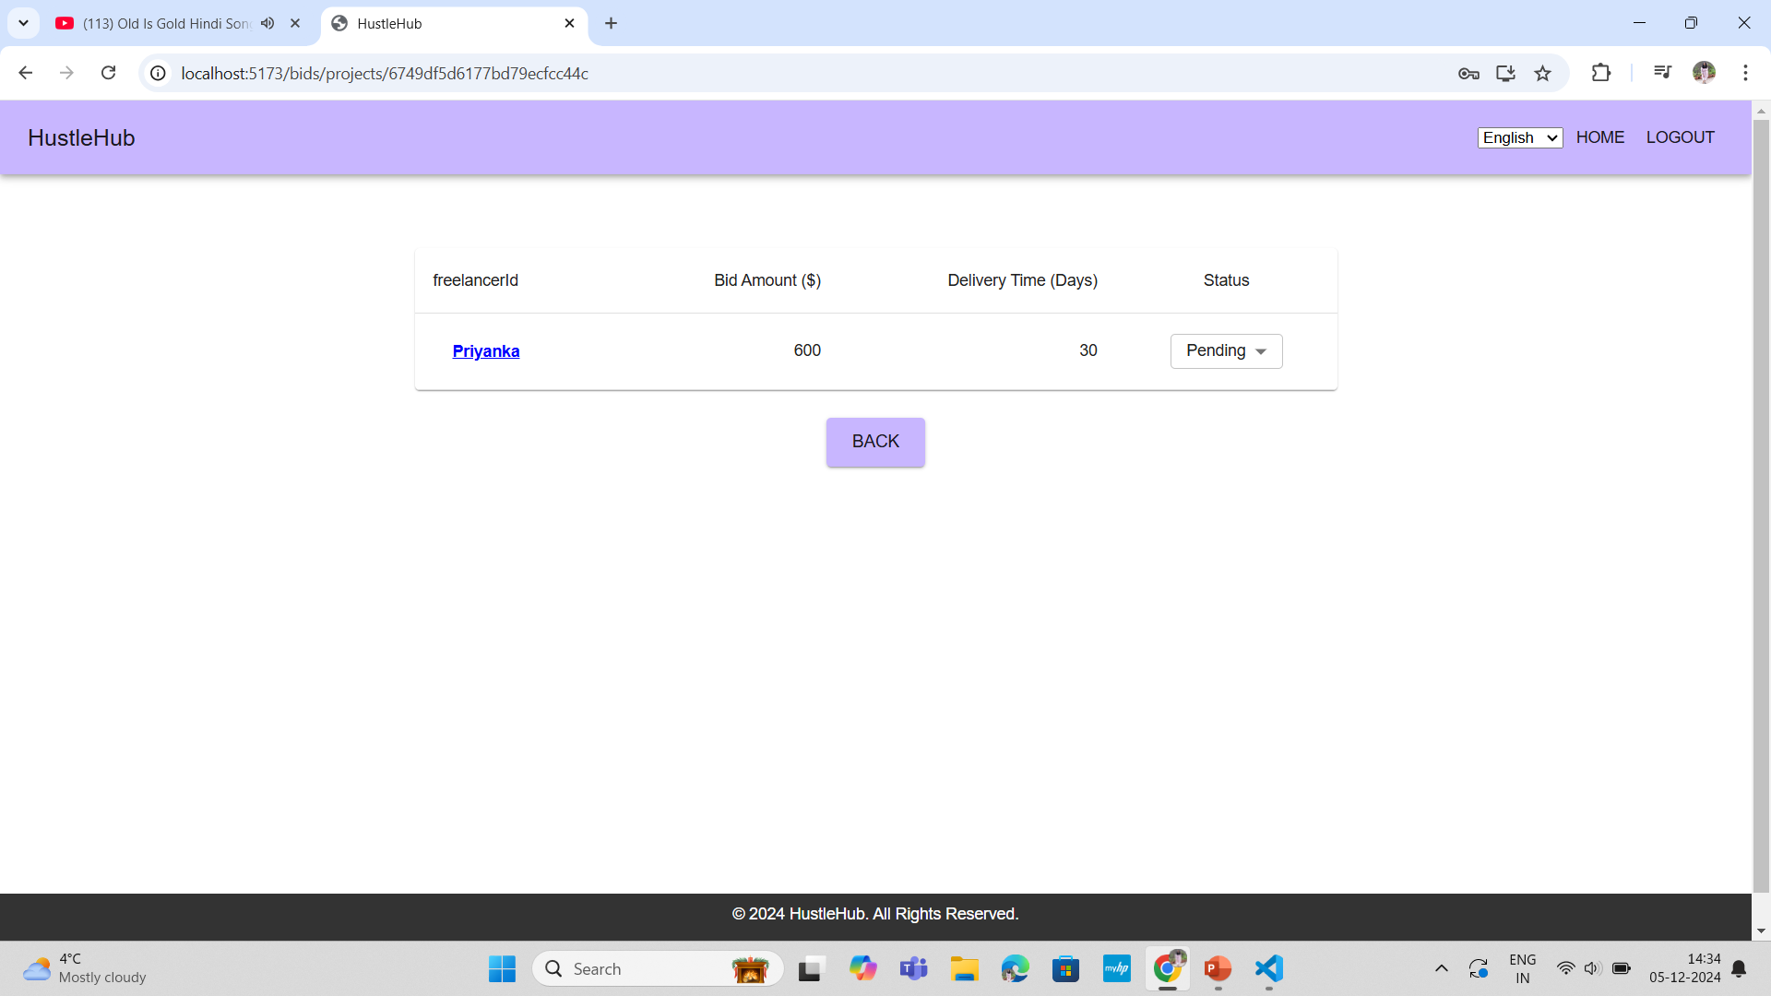
View Bid

Slide 15
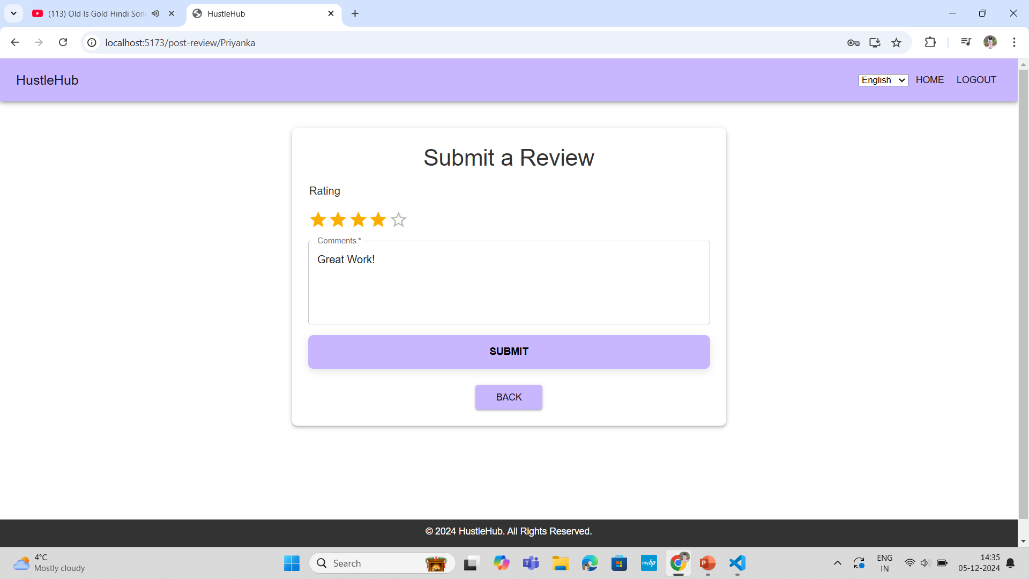
Post Review Form

Slide 16
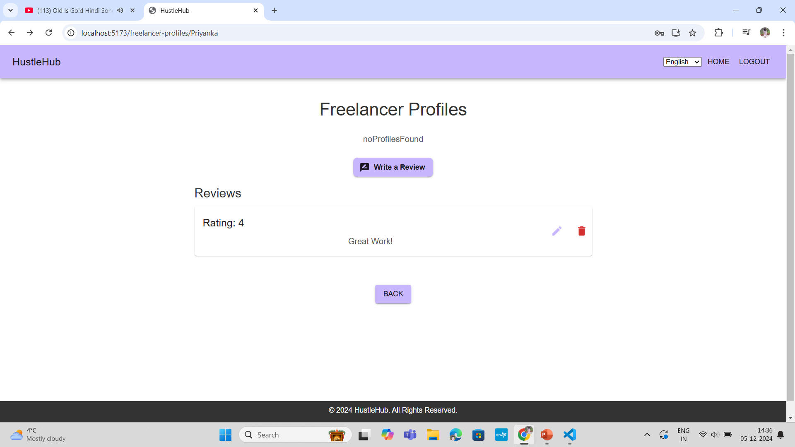
Review List

Slide 17
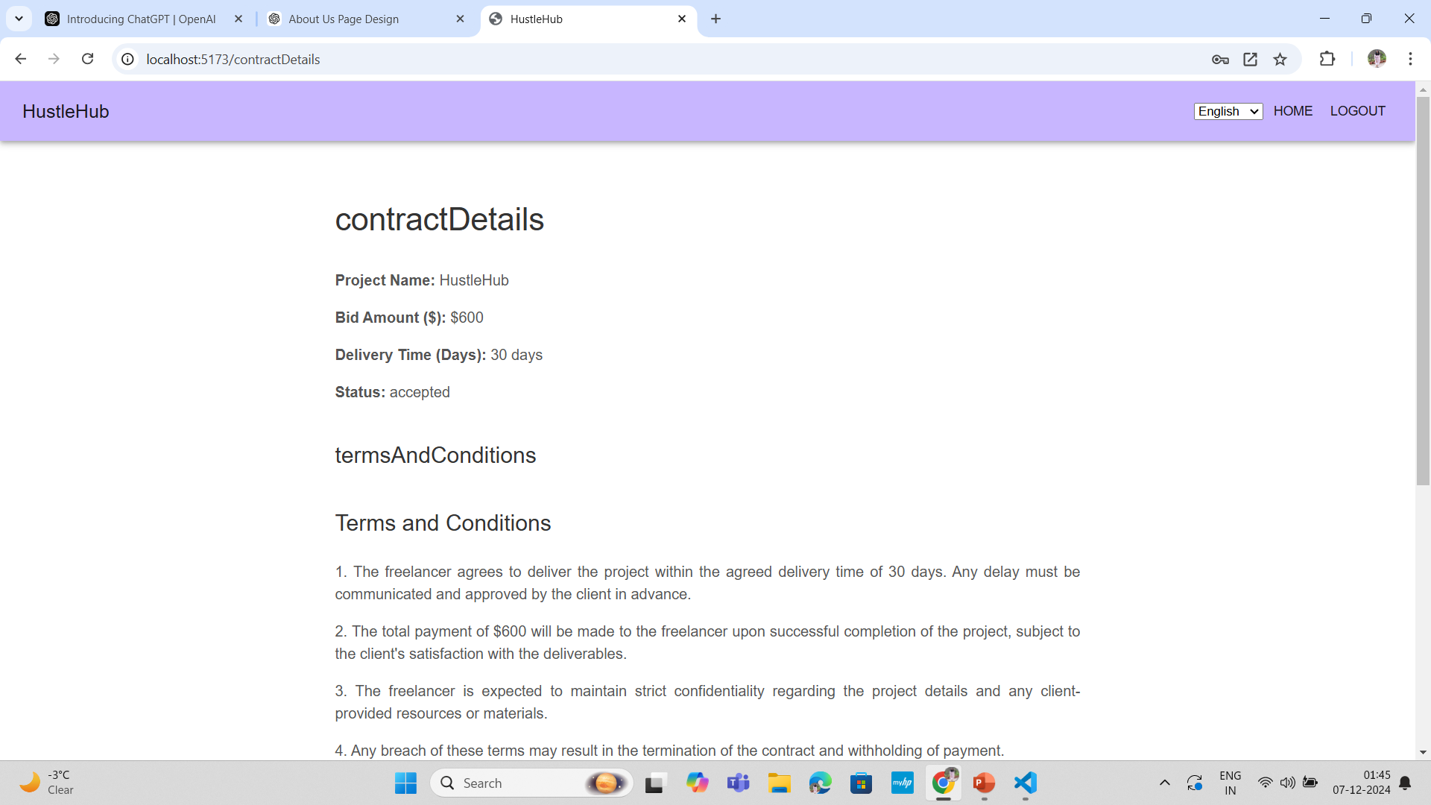
Contract Page

Slide 18
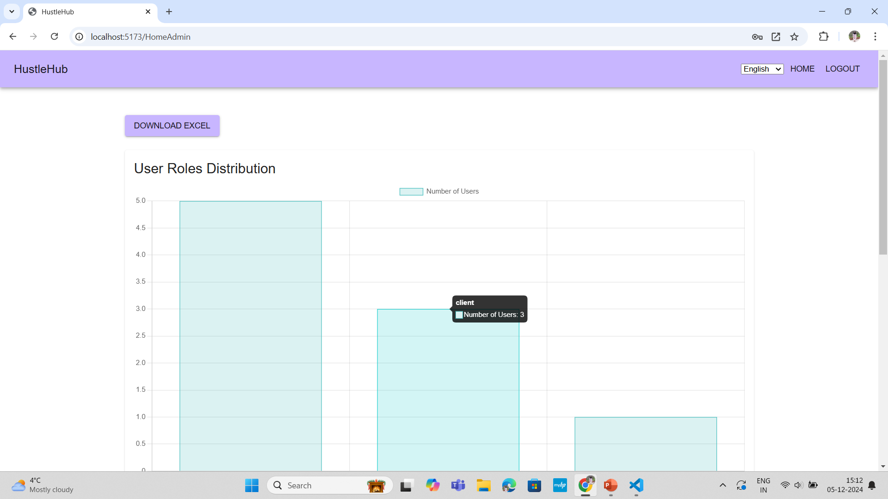
Admin Dashboard

Slide 19
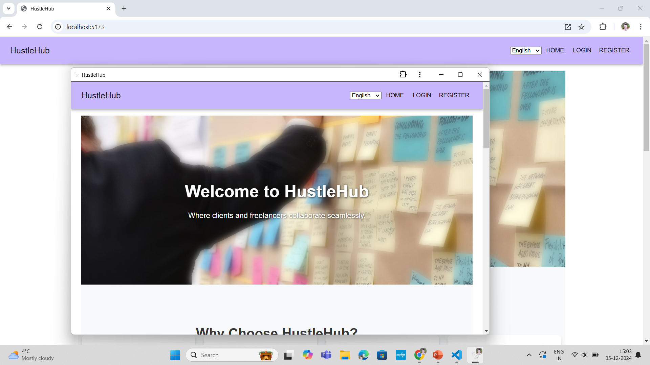
PWA Feature

Slide 20
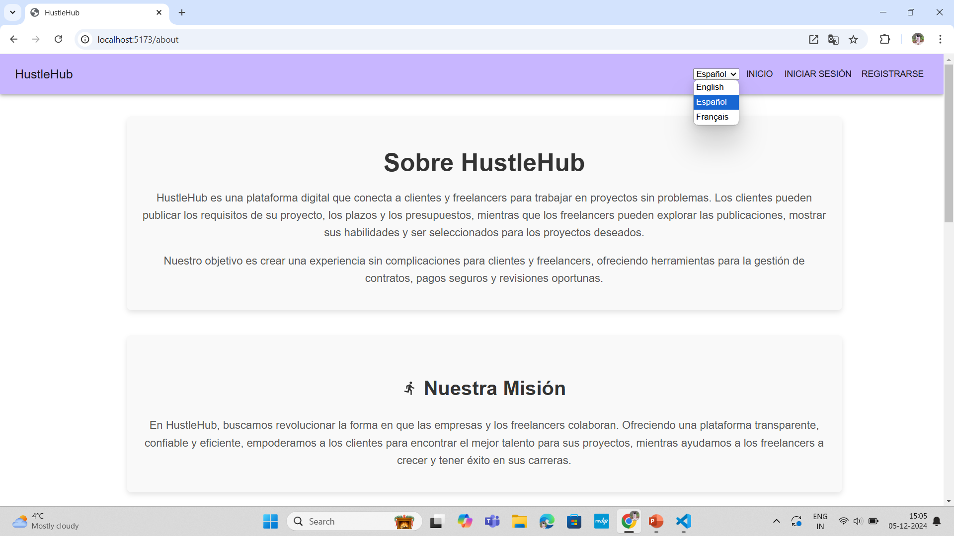
Internationalization Feature

Slide 21

Thank You!

